Slide 1
Machine Leaning in Acoustic Primatology
Xunmo Yang

Slide 2
Do Animals Have Language
Human’s language ability is distinctive, while animals do show some primitive speaking abilities.
The first clear evidence was found in vervet monkey, which has been found to use three types of alarms in wild, i.e., snake alarms, eagle alarms, and leopard alarms. Each alarm evokes contrasting responses. Monkeys on the ground respond to leopard alarms by running into trees, to eagle alarms by looking up, and to snake alarms by looking down.
Playback experiments confirmed that the responses were triggered by sound.
Seyfarth R M, Cheney D L, Marler P. Vervet monkey alarm calls: semantic communication in a free-ranging primate[J]. Animal Behaviour, 1980, 28(4): 1070-1094.
Seyfarth R M, Cheney D L, Marler P. Monkey responses to three different alarm calls: evidence of predator classification and semantic communication[J]. Science, 1980, 210(4471): 801-803.

Slide 3

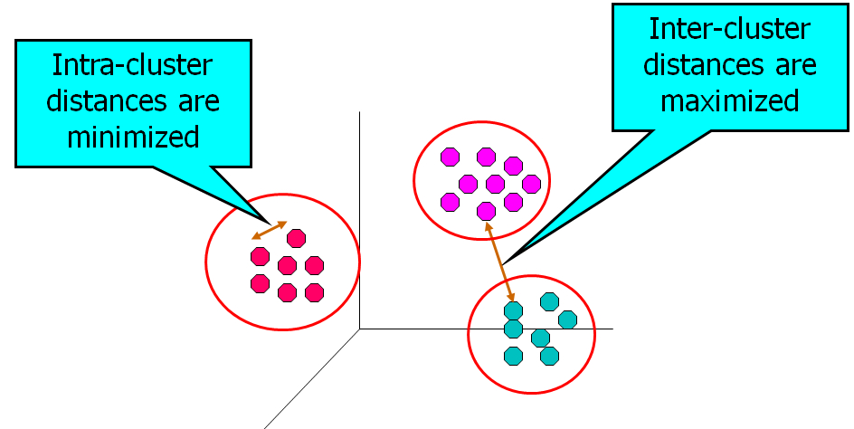
How to Understand Animal’s Language
Snake
Eagle
Leopard
These are not hard to distinguish by ears, but how about more similar cases? What if primatologists don’t agree to each other? Is there any more objective way?
Yes, in machine learning we have cluster analysis techniques.
http://pin.primate.wisc.edu/factsheets/entry/vervet/behav
https://apandre.wordpress.com/visible-data/cluster-analysis/

Slide 4
Cluster Analysis
There’re various ways to classify points to different clusters. k-means clustering is one of them, being relatively easy to understand.
Procedure:
Randomly initialize n centroids for n clusters wanted;
Repeat until no more change:
Each data point is assigned to its nearest centroid;
Centroids are updated to be the center of all points in the corresponding cluster.
http://shabal.in/visuals/kmeans/1.html

Slide 5
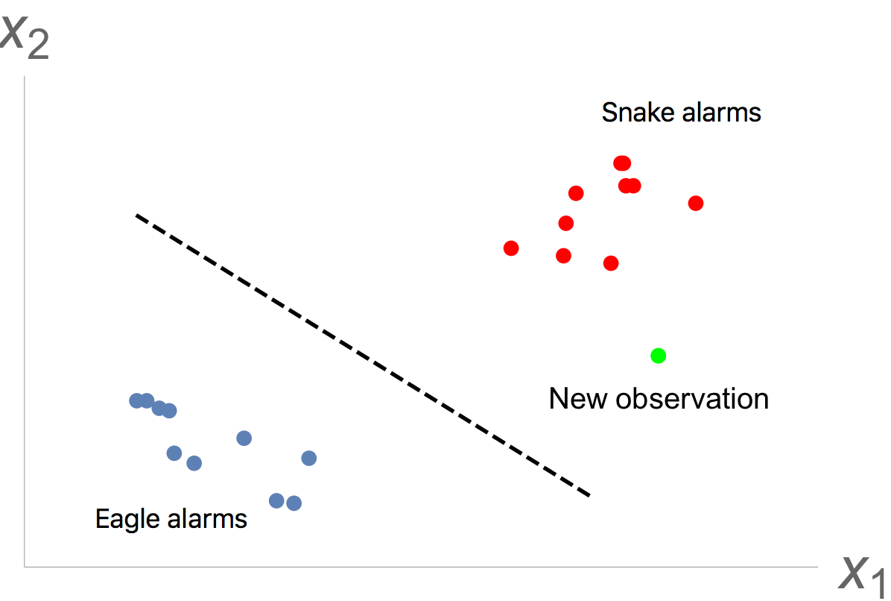
Supervised Learning after Confirmation
Once the clusters obtained agree to those decided by primatologists, we can turn to supervised learning.
A trained classifier can predict the possible type of new observations. It can be implemented on laptops, or even smart phones. In that case, primatologists working in the wild can use a phone to record animal’s speech then the possiblemeaning will be returned shortly.

Slide 6
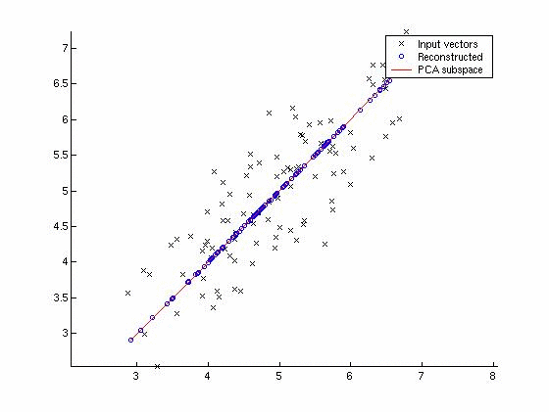
A Summarized Procedure
Principal Component Analysis (PCA)
Records collected
Pre-processing, e.g., background noise reduction
Feature extraction, may followed by dimensionality reduction, e.g., PCA
Cluster analysis
Supervised learning
Can be used as a black box for primatologists
http://math.stackexchange.com/questions/1146/intuitive-way-to-understand-principal-component-analysis

Slide 7
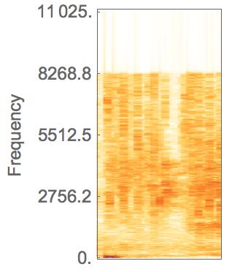
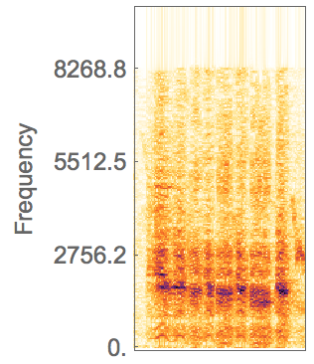
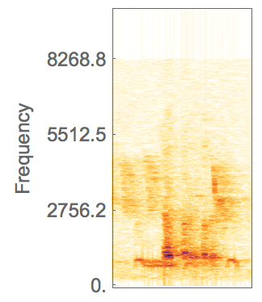
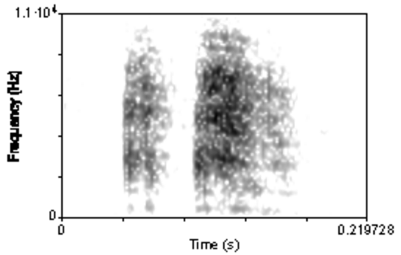
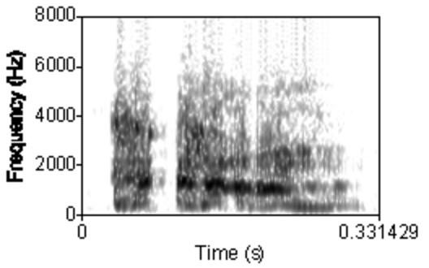
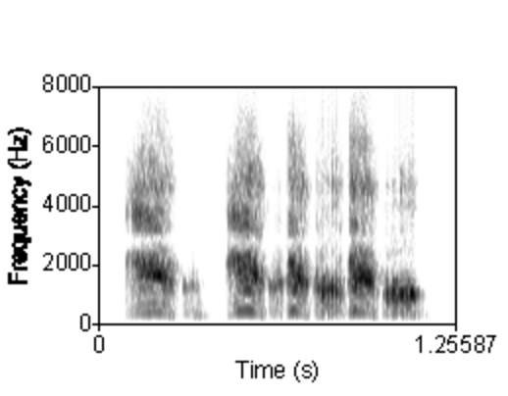
A Primitive Study
I extracted the audio track on http://www.arkive.org/vervet/chlorocebus-pygerythrus/video-11a.html, manually truncated it to small parts containing different type of alarms, and made some analysis.
Spectrogram: Snake Eagle Leopard
Previous study
http://www.psych.upenn.edu/~seyfarth/Baboon%20research/vervet%20vox.htm

Slide 8
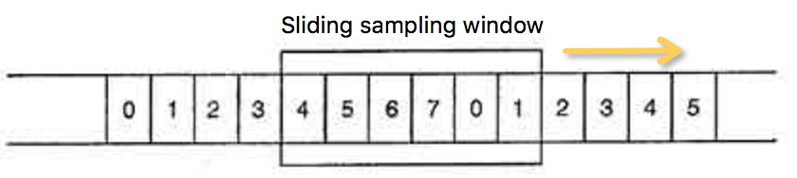
Cluster Analysis
For each small record extracted:
The sampling frequency is reduced to 22.05kHz;
A fast Fourier transform applied to frames sampled by a sliding Hamming window, with 93.75% overlap. Each frame includes 1024 continuous points;
Weak frames (average amplitude < 1) are discarded;
PCA applied, with 99% variance conserved;
Data then sent to FindClusters function in Mathematica to be classified into 3 clusters.
 | Snake | Eagle | Leopard
Cluster1 | 1575 | 495 | 356
Cluster2 | 28 | 812 | 28
Cluster3 | 0 | 0 | 608

Slide 9
Thank you!

